Slide 1
Y4 Residential Malvern Boundless Outdoors
Wednesday 1st May - Friday 3rd May 2024

Slide 2
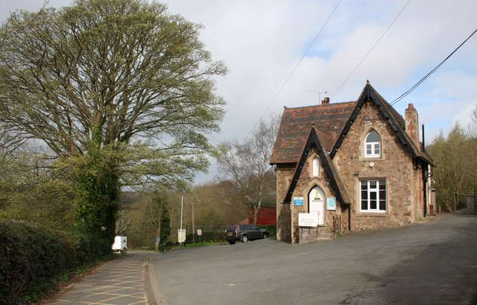
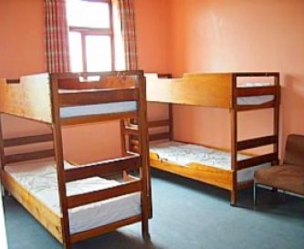
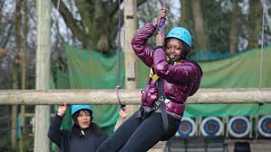
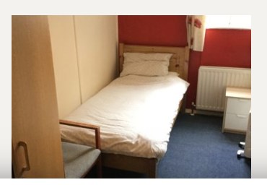
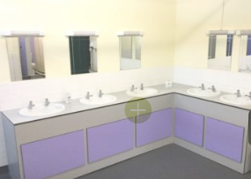
Malvern Boundless Outdoors

Slide 3
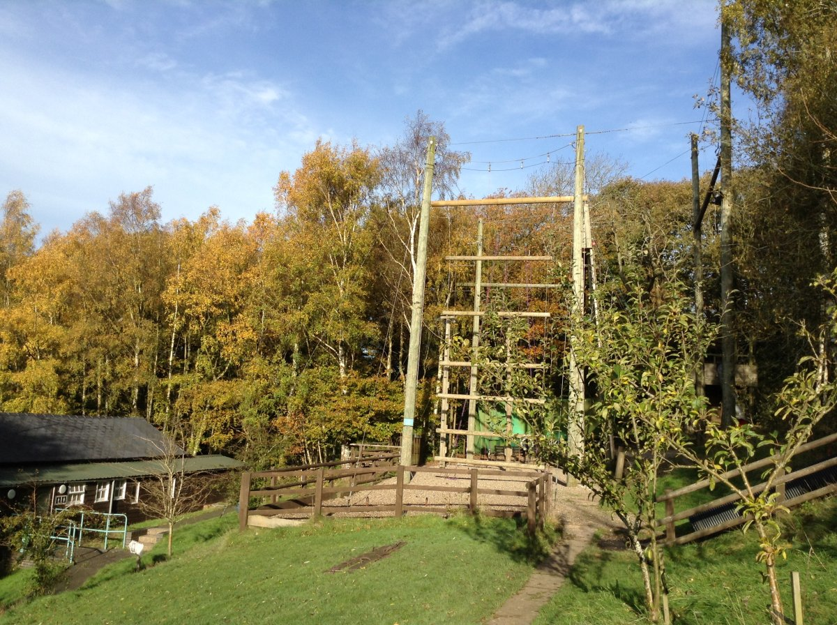
Possible Activities
Blind Trail
Walk the Malvern hills
Archery
Low Ropes Course
Problem Solving
Obstacle Course
Abseil
Zip Wire
Bush Craft

Slide 4
Key Information
Two nights stay
Secure overnight accommodation
24 hour duty manager
Three meals a day provided
Dormitory accommodation/shared bathrooms/bunkbeds/single beds
Hot and cold menus including vegetarian, vegan and salad options
All bedding is provided - please teach them how to put a duvet and pillow case in their covers
A range of exciting activities each lasting 1.5 hrs each
Fully qualified staff
Insurance included
Estimated cost around £220 - letter to follow

Slide 5
Key Information
Departing from school at approximately 9.45am
Returning to school by 3.15pm on the last day.
Kit list – provided later
Packed lunch required on the day we go in a separate bag
Lunch provided on the last day.
Hot chocolate/juice/water and snack provided before bed
Behaviour expectations.
Emergency contact/consents
Medical and dietary requirements consents –let us know
Books and card games for journey
No electronic games equipment or phones please
£5 money needed for the shop
Room allocation and activity groups on arrival
Benefits include, independence, resilience, self-belief, co-operation, problem solving, empathy and team work

Slide 6
Payments
A deposit of £50.00 will be required before October half term.
Payments can be made online using School Money.
Regular instalments can be paid using School Money.
The final balance needs to be paid by January.
A letter will follow with these details.
If your child is eligible for Pupil Premium or Free School Meals the cost is covered by the school.

Slide 7
Any questions?

